Slide 1
Name : Anjali kumari Roll no : 8 Dept. : IT Year : 4th (8th sem) Subject : cyber law & security Policy assignment

Slide 2
Topic Name :-
Patriot hacking

Slide 3
Patriotic hacking is a term for computer hacking or system cracking in which citizens or supporters of a country, traditionally industrialized Western countries but increasingly developing countries, attempt to perpetrate attacks on, or block attacks by, perceived enemies of the state.

Slide 4
Topic Name :-
Cyberdefamation

Slide 5
The term ‘Cyber Defamation’ basically means publishing of false statement about an individual in cyberspace that can injure or demean the reputation of that individual. In India, defamation can be contemplated as both civil and criminal offence, and thus legal remedies are provided to the victims by the Indian judiciary system.

Slide 6
Topic Name :-
Cloud computing

Slide 7
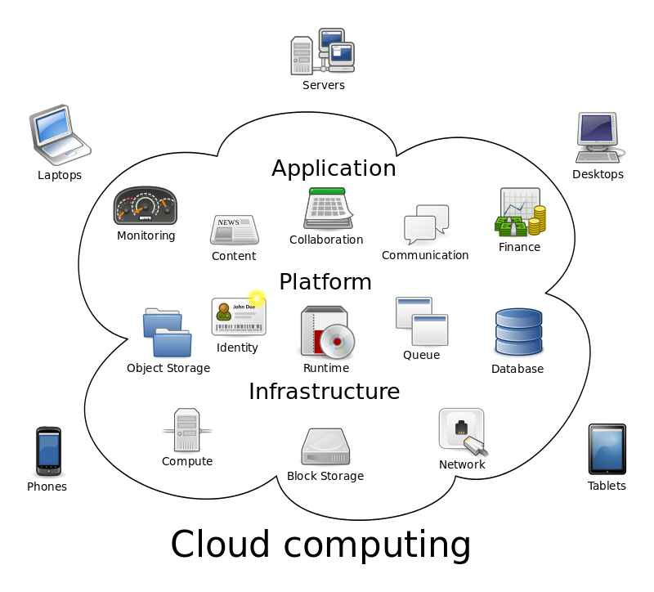
Cloud computing is the on-demand availability of computer system resources, especially data storage (cloud storage) and computing power, without direct active management by the user. The term is generally used to describe data centers available to many users over the Internet.

Slide 8
Types of cloud :-
There are four types of cloud:
1. Public cloud 2. Private cloud 3. Hybrid cloud 4. Community cloud

Slide 9
Public cloud: Public cloud are managed by third parties which provide cloud services over the internet to public, these services are available as pay-as-you-go billing mode. They offer solutions for minimizing IT infrastructure costs and act as a good option for handling peak loads on the local infrastructure. They are a goto option for small enterprises, which are able to start their businesses without large upfront investments by completely relying on public infrastructure for their IT needs. A fundamental characteristic of public clouds is multitenancy. A public cloud is meant to serve multiple users, not a single customer. A user requires a virtual computing environment that is separated, and most likely isolated, from other users

Slide 10
Private cloud : Private clouds are distributed systems that work on a private infrastructure and providing the users with dynamic provisioning of computing resources. Instead of a pay-as-you-go model as in public clouds, there could be other schemes in that take into account the usage of the cloud and proportionally billing the different departments or sections of an enterprise.

Slide 11
Hybrid cloud: Hybrid cloud is a heterogeneous distributed system resulted by combining facilities of public cloud and private cloud. For this reason they are also called heterogeneous clouds. A major drawback of private deployments is the inability to scale on demand and to efficiently address peak loads. Here public clouds are needed. Hence, a hybrid cloud takes advantages of both public and private cloud.

Slide 12
Community cloud: Community clouds are distributed systems created by integrating the services of different clouds to address the specific needs of an industry, a community, or a business sector. In community cloud, the infrastructure is shared between organization which have shared concerns or tasks. The cloud may be managed by an organization or a third party.

Slide 13
Topic Name :-
Cybercrime

Slide 14
Cybercrime, or computer-oriented crime, is a crime that involves a computer and a network. The computer may have been used in the commission of a crime, or it may be the target.Cybercrime may threaten a person or a nation's security and financial health.

Slide 15
Common forms of cybercrime Common forms of cybercrime include: 1. phishing: using fake email messages to get personal information from internet users; 2. misusing personal information (identity theft); 3. hacking: shutting down or misusing websites or computer networks;

